Slide 1


Cardio Predict
TEAM MEMBERS
MUHAMMAD OWAIS (TEAM LEADER)
ABDUL HANAN
ZAHID HUSSAIN

Slide 2

Scope & Objective:
Objective: The goal of this project is to develop a predictive model that accurately classifies individuals as at-risk or not at-risk for heart disease based on clinical and demographic features. The project will involve analyzing the dataset, selecting important features, and training machine learning models to predict the presence of heart disease.
Scope:
The scope of a heart disease dataset includes various features collected from patients that can help predict or analyze the presence and severity of heart disease.
Clinical Data: age, gender, blood pressure, cholesterol levels, blood sugar, etc.
Lifestyle Data: Smoking status, alcohol use, physical activity.
Outcome Data: Indications of disease presence or severity, such as diagnosis labels (0 for no heart disease, 1 for presence of disease), type of heart disease, and survival or recovery rates.

Slide 3
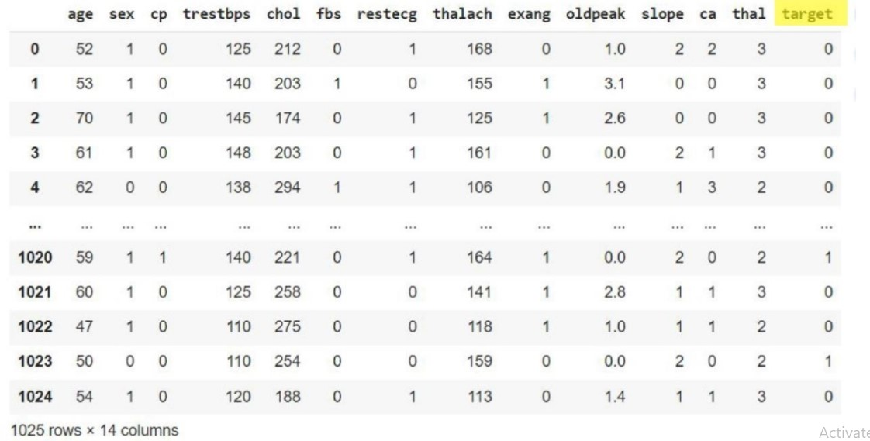
Data Overview
Data Source : https://drive.google.com/file/d/1UpTGf0j4DdzyhzCe5ytKgtarituZqoNu/view?usp=drive_link
Data Shape : (1025, 14) means we have 1025 rows and 14 columns (features).

Slide 4
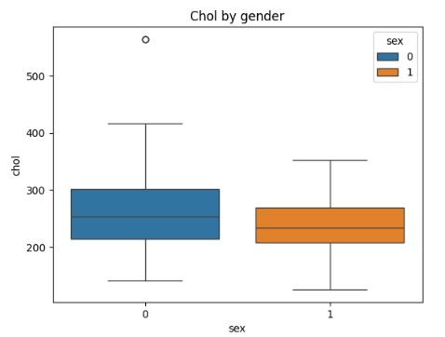
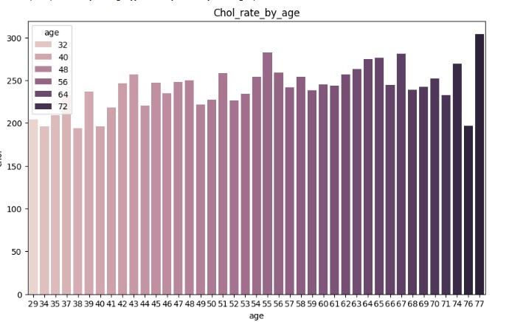
EDA Highlights
Summarize notable trends
Chol by gender :
This plot shows the cholesterol levels for each gender. By comparing the cholesterol distribution between males and females, you can observe if one gender tends to have higher cholesterol levels, which can help identify gender-based health risks.
Chol by age :
This plot illustrates how cholesterol levels vary across different ages. By examining this, you can see if cholesterol tends to increase with age or identify specific age groups that may be more prone to high cholesterol, which can guide age-focused health interventions.
Chol by gender
Chol by age

Slide 5
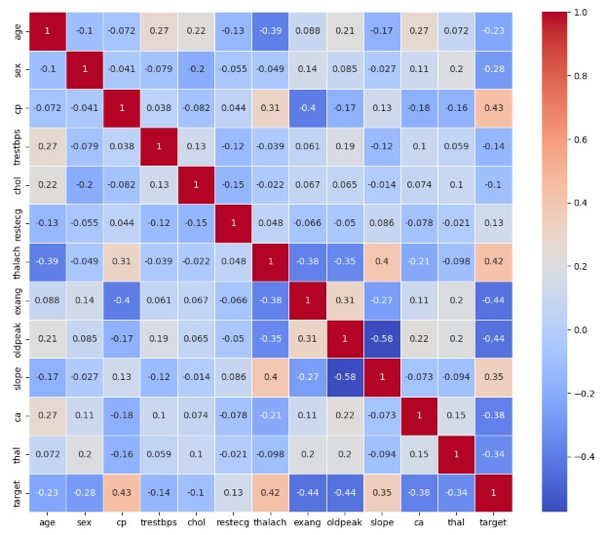
Correlation Heatmap
Data set Correlation
This heatmap displays the correlation between different features in the dataset, including cholesterol. Correlation shows how strongly two variables are related. For example, if cholesterol is highly correlated with age or other health indicators, it may be a key factor in predicting certain health outcomes.

Slide 6
Models Used
ML Models Used
Deep Learning Model Used
Multi-layer Perceptron (MLP)
Logistic Regression
SVM (Support Vector Machine)
Decision Tree
Random Forest
k-Nearest Neighbors (k-NN)

Slide 7
Model Name | Accuracy
Logistic Regression | 79.51%
SVM (Support Vector Machine) | 97.07%
Decision Tree | 97.56%
Random Forest | 98.54%
k-Nearest Neighbors (k-NN) | 95.61%
Multi-layer Perceptron (MLP) | 93.66%
Results

Slide 8

Key Takeaways:
The model successfully predicts heart disease with an accuracy of 98.54%
Recommendations:
Use the model’s predictions to support preventative healthcare screening By identifying individuals at high risk, the model can aid in early intervention strategies and tailored health plans
Future Work:
Data Collection:
Expand the dataset by incorporating data from diverse populations to improve model robustness and generalizability.
Feature Engineering:
Explore additional features that could improve the model’s accuracy, such as lifestyle factors, genetic information, or more detailed medical history
Model Tuning:
Experiment with other algorithms and fine-tuning techniques, like specific tuning method, hyperparameter optimization, to improve model performance.
Real-World Testing:
Conduct a pilot study to evaluate the model’s effectiveness in a real-world healthcare setting
BY :
Muhammad Owais
Abdul Hanan
Zahid Hussain
Submitted to : Engr Reema Memon

